Slide 1
Topic 8: Generalized Linear Models

Slide 2
Outline
Background
Commonly used Generalized Linear Models
Goodness of fit
Logistic regression
Poisson regression and beyond

Slide 3
Background
Generalized Linear Models (GLMs) are an extension of linear models that allow for:
a nonlinear link function for nonlinear y’s
response probability distributions can be any member of the exponential family of distributions (e.g., normal, inverse normal, gamma, binomial, negative binomial, Poisson and multinomial).
Unequal variances of the y’s (variance of the y’s is a function of the mean of y, given x)
Errors are uncorrelated for ease of calculation of the likelihood
NOTE: If errors are correlated, Generalized Estimating Equations (GEEs) can be used

Slide 4
Background (cont.)
For the OLS model:
For GLM’s, this is extended to:

Slide 5
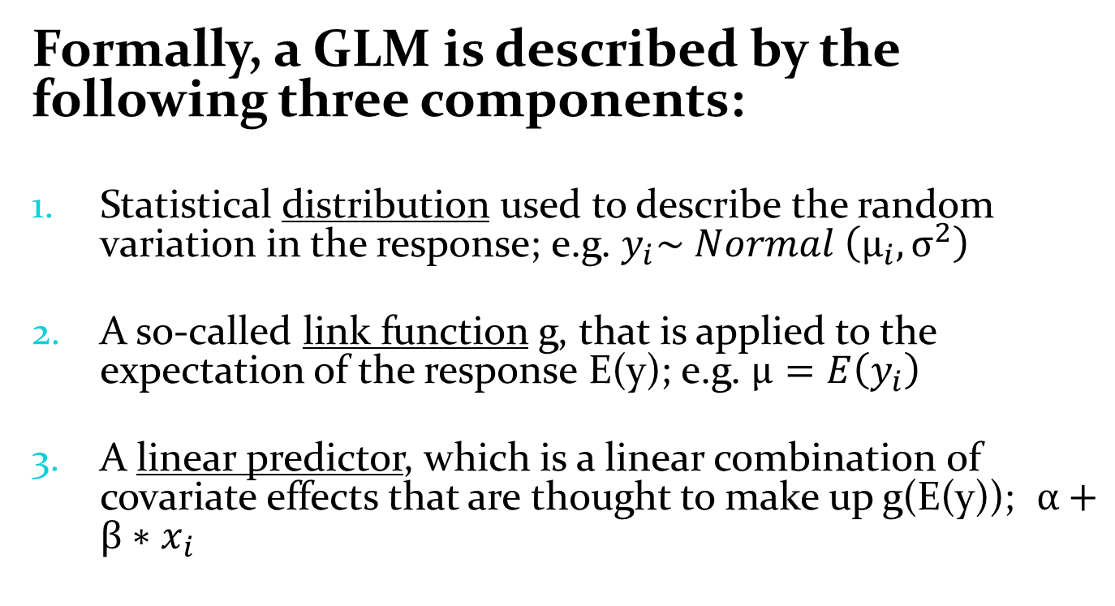
Background (after Kery 2010*)
Formally, a GLM is described by the following three components:
Statistical distribution used to describe the random variation in the response; e.g. $y_{i}\sim Normal \left(μ_{i},σ^{2}\right)$
A so-called link function g, that is applied to the expectation of the response E(y); e.g. $μ=E\left(y_{i}\right)$
A linear predictor, which is a linear combination of covariate effects that are thought to make up g(E(y)); $α+β∗x_{i}$
*Kery (2010) Introduction to WinBUGS for Ecologists. Academic Press.

Slide 6
Commonly Used GLM’s
1. OLS model: y is continuous, LINK=identity, DIST=normal
2. Logistic Regression: y is a proportion (or a 0,1 Bernoulli variable), LINK=logit, DIST=binomial
3. Poisson Regression, log linear model: y is a count (no natural denominator, else use y as a proportion), LINK=log, DIST=Poisson
4. Count using Negative Binomial: y is a count (no natural denominator, else use y as a proportion), LINK=log, DIST=negbin
5. Gamma Model with log linear model: y is a positive continuous variable, LINK=log, DIST=gamma.

Slide 7
Under/Overdispersion
If default variance for specified distribution does not match the data:
data are over- or underdispersed.
Can happen with Poisson, binomial, negbin
Overdispersion factor can be added to the variance function and an estimate of this found by MLE along with the other parameters.
Alternatively: another distribution may be more appropriate (e.g., switch to negative binomial for count data).

Slide 8
Model Goodness of Fit
Asymptotic z-test for individual coefficients.
Likelihood ratio test for nested models. Better models have higher likelihood (or log likelihood), which is the same as saying the -2 lnL is smaller.
Pseudo R squared value, based on lnL of the model versus lnL for a “null model” with only the intercept (no explanatory variables), to obtain a similar interpretation to R² for linear models.

Slide 9
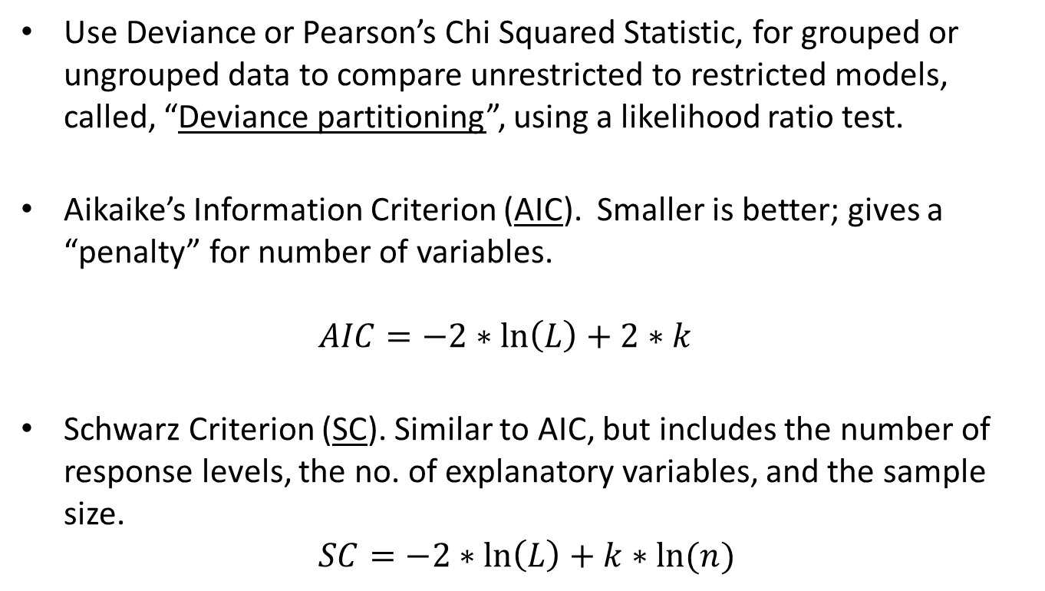
Model Goodness of Fit
Use Deviance or Pearson’s Chi Squared Statistic, for grouped or ungrouped data to compare unrestricted to restricted models, called, “Deviance partitioning”, using a likelihood ratio test.
Aikaike’s Information Criterion (AIC). Smaller is better; gives a “penalty” for number of variables. $AIC=−2∗\ln\left(L\right)+2∗k$
Schwarz Criterion (SC). Similar to AIC, but includes the number of response levels, the no. of explanatory variables, and the sample size.
$$SC=−2∗\ln\left(L\right)+k∗ln⁡(n)$$

Slide 10
Logistic Regression + Predictive Habitat Map Example
For many problems, the y variable is a Bernouilli random variable (0/1):
Detection versus non detection of an animal
Healthy versus diseased animal
Dead versus live trees
Can be summarized into a Binomial Distribution which gives the proportion of successes (p) versus failure (q=1-p).
We then wish to use a model to predict this y variable, given a set of explanatory variables, x, which can be continuous variables, class variables represented by a set of dummy variables, and interactions between continuous and class variables.
The predicted values from this model will be the probability that y=1.

Slide 11
Logistic Regression (cont.)
Using the logarithm of the odds ratio as a linear function of the x variables:
This is called a “logistic function”. It is constrained to give predictions between 0 and 1, which are probabilities that y=1.

Slide 12
Goodness of Fit (additions)
Number of Concordant/Discordant/Ties.
Classification Table: shows the results for different probability “cutoff” values.
Receiver Operating Characteristic Curves (ROC) ; Area Under the Curve (AUC)

Slide 13

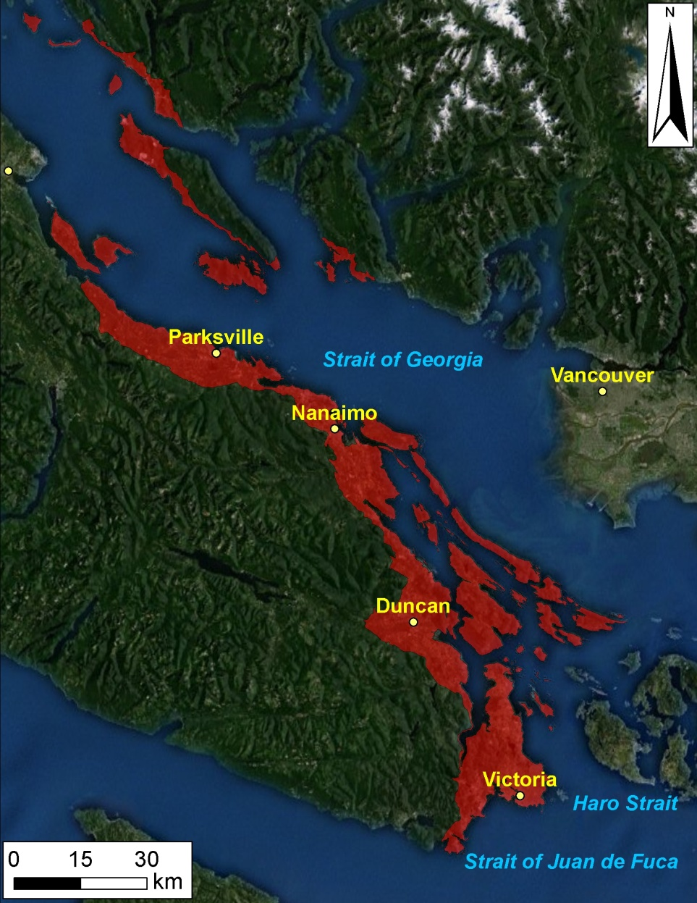

Predictive Habitat Map Example
Coastal Douglas Fir Zone: Most Imperilled Ecosystem in BC
>60% Converted to Human Use
~84% Private Land
<1% Old-Growth Forest
115 ‘Species At Risk’
Study area: ~2120 km²
Austin et al. (2008); Madrone Env. Services (2008)

Slide 14
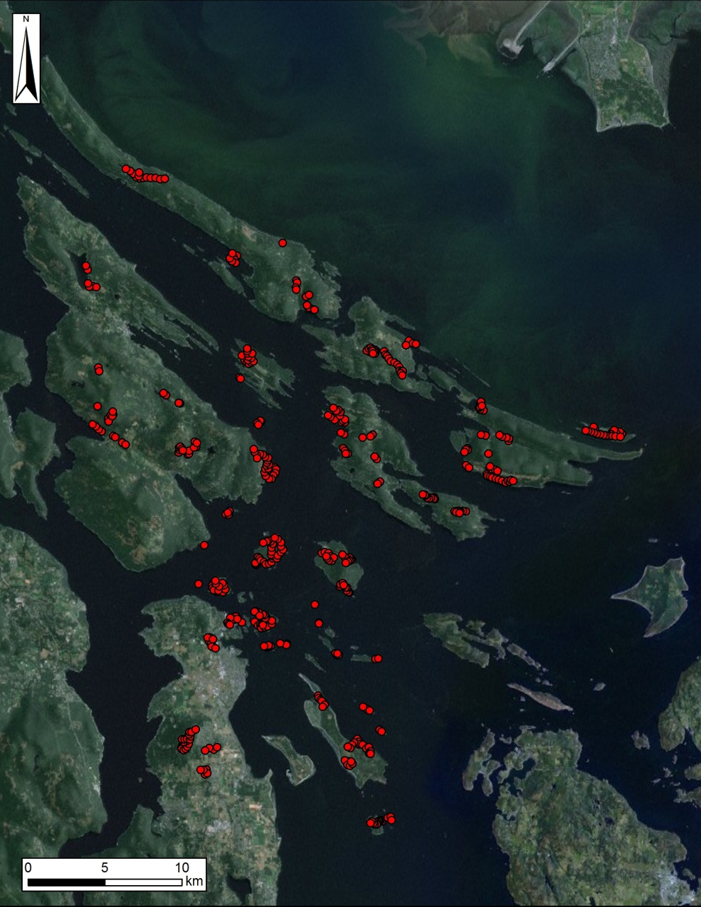
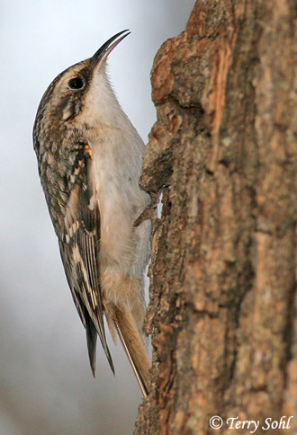
Data
presence/absence data
~460 plots
Brown Creeper as an example

Slide 15
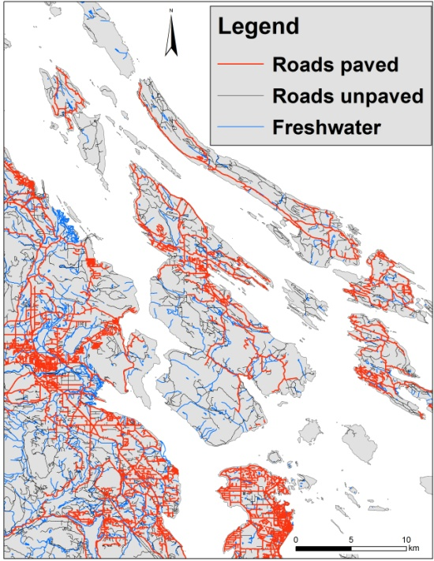
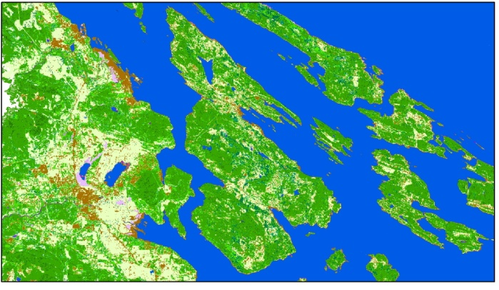
Model covariates
Coarse (1km) and fine scale (100m)¹
25 landscape covariates
e.g. road length; urban; rural; young and older forest; nearest water
Using: Hawth‘s Tools, ArcGIS, Geospatial Modelling Environment, R
¹Guisan and Thuiller, 2005; Jewell et al., 2007

Slide 16

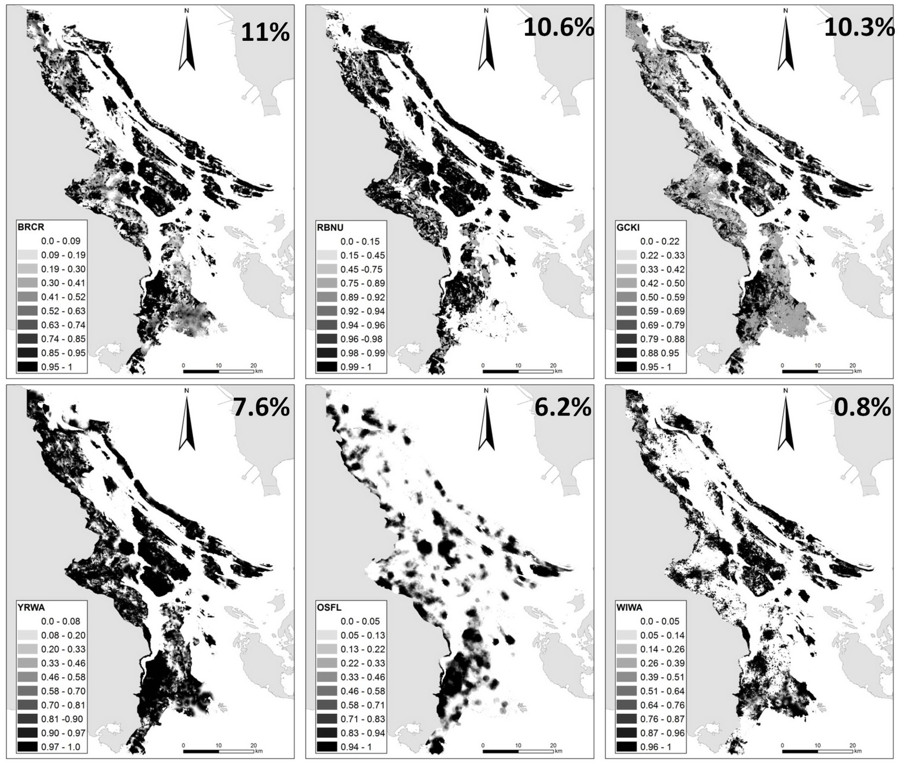

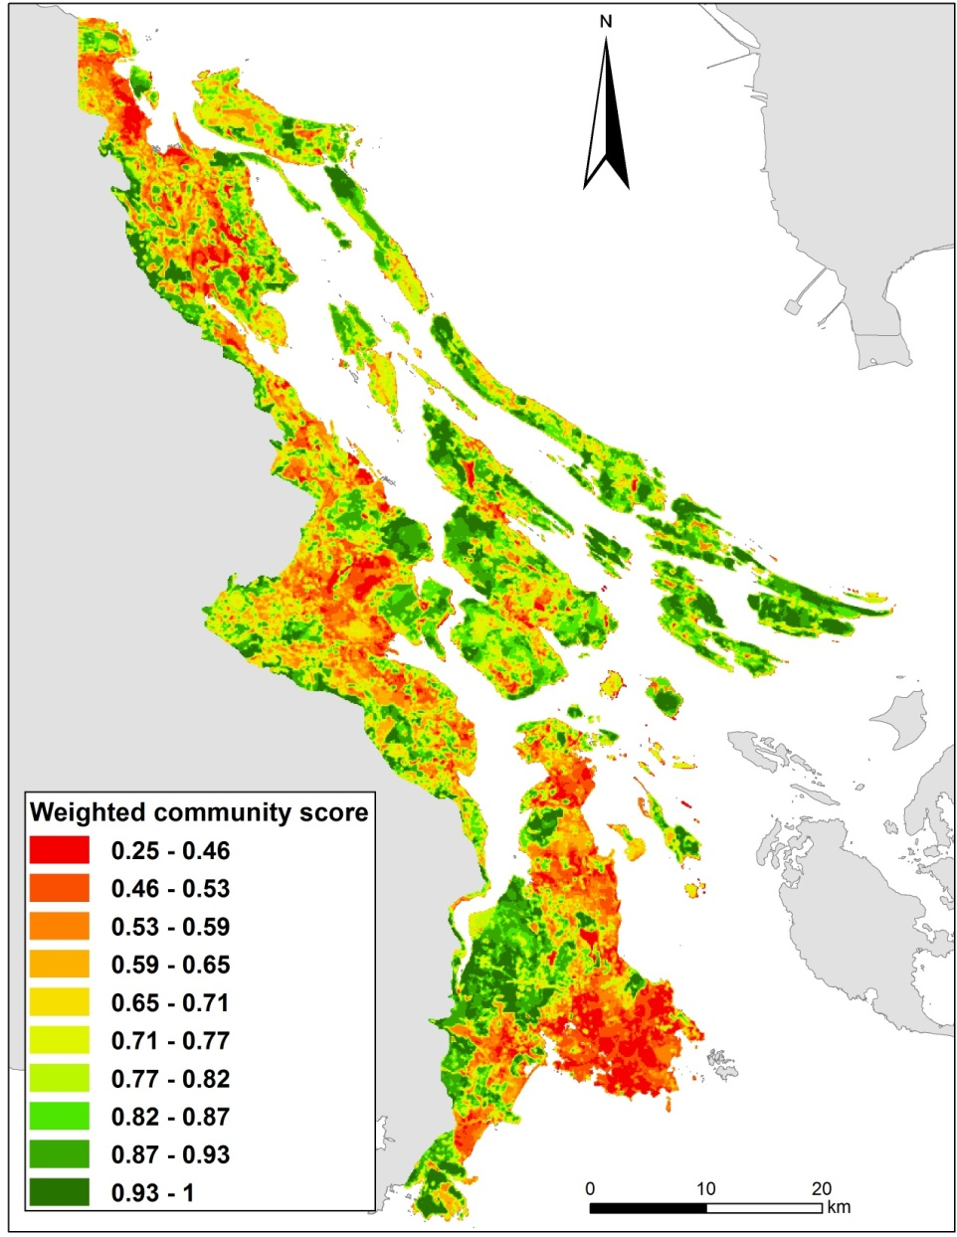



Slide 17
Example in R
Package: MASS
Function: glm()
brcr_m1 <- glm(BRCR ~ CR_CL_2Z, family=binomial, data=brddata)
For help on this (or any other) function use:
help(glm) or ?glm

Slide 18
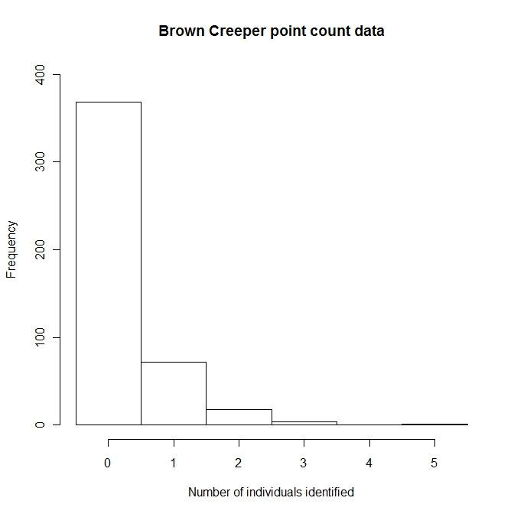
Other GLM’s and overdispersion
Poisson
Negative Binomial (NB)
Zero Inflated Poisson
Zero Inflated NB

